Slide 1
Hands on Labs

Slide 2
Agenda
HOL 1 - Tools and Developer Environment Setup
HOL 2 - Modern Cloud Apps
HOL 3 - Identity and Office365 APIs
HOL 4 - DevOps Continuous integration
HOL 5 - Infrastructure as code
HOL 6 - Monitoring

Slide 3
Intro to Scenario
City Power & Light is looking to use cloud capabilities
Would to allow field workers the ability capture incidents
Would like to provide photo upload capability
Would like to consume PaaS services on Azure

Slide 4
Demo
City Power and Light
Notes:
Demo steps
Show site
Login with Azure AD
Create new incident
Show dashboard
Show profile

Slide 5
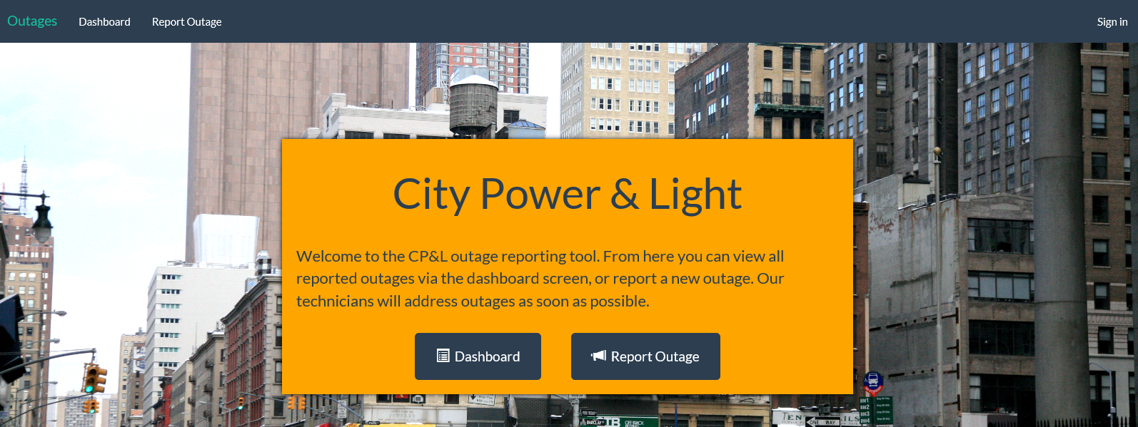
City Power & Light Outage Incident Tracker

Slide 6
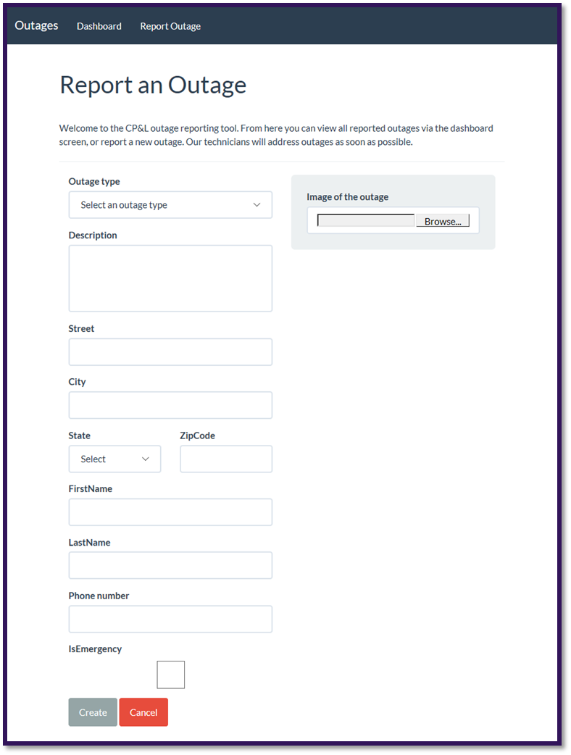
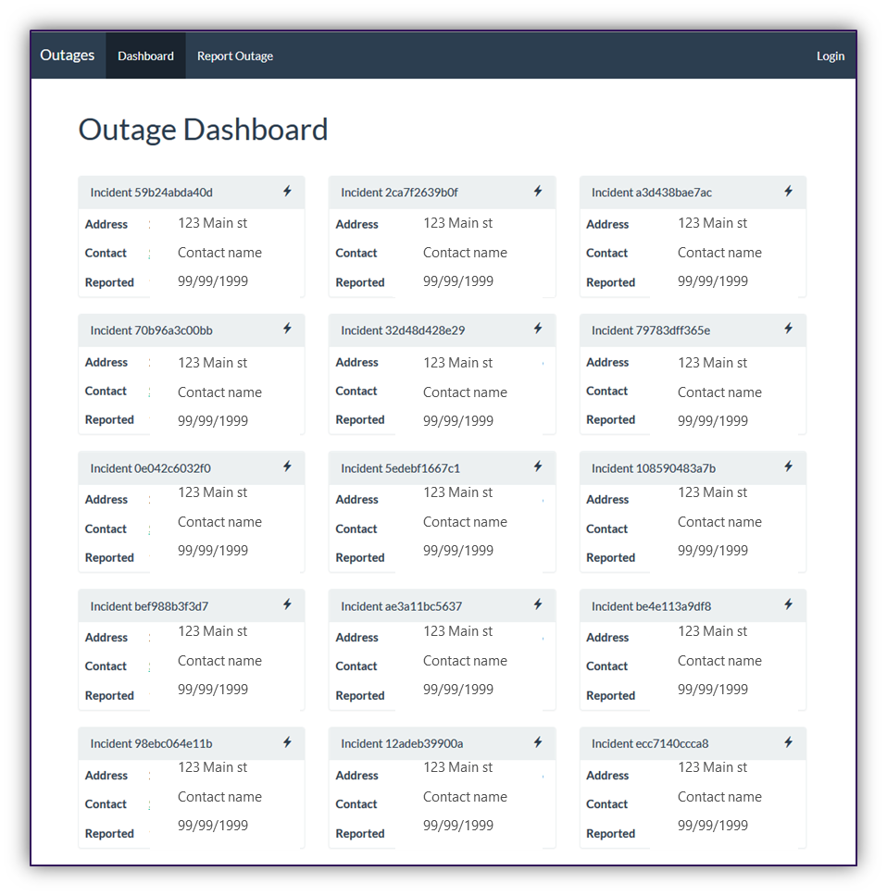
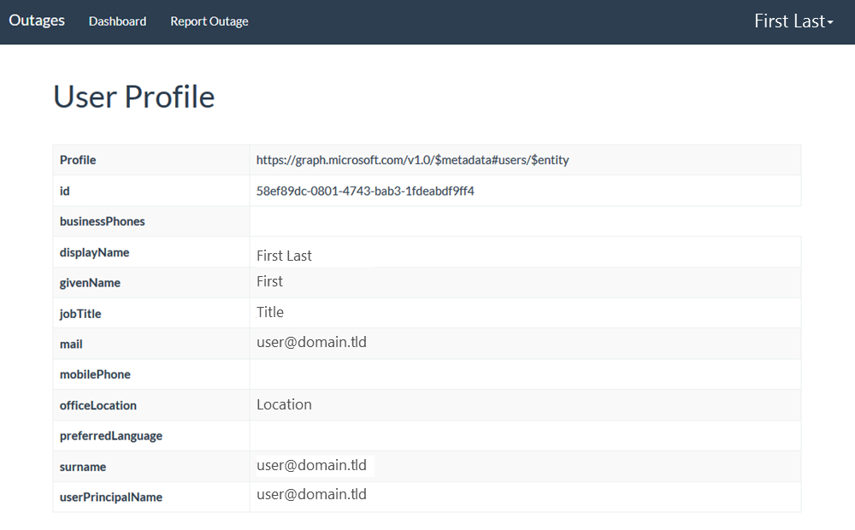
Screenshots

Slide 7


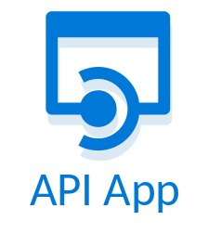
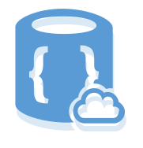


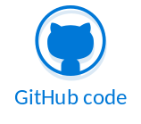
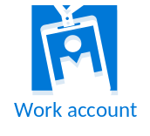


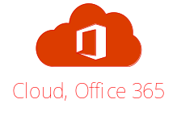


City Power & Light App Architecture
START
8
3
4
AZURE DOC DB
AZURE API APP
AZURE CACHE
1
Dashboard
WEB SITE
New Incident
Incident Tracker
Email
Images
6
AZURE QUEUE
2
7
5
9
AZURE BLOB STORAGE
AZURE FUNCTION
AZURE AD
O365 APIs

Slide 8
Components Covered in this Course
Azure
  Azure Resource Manager
  Virtual Machines (Windows & Linux)
  Azure AD
  Web Applications
  API Apps
  Redis Cache
  Document DB
Office 365
  Graph API (users, OneDrive for Business, Skype for Business)
Visual Studio Team Services
  Source Control integration (GIT)
  Continuous Integration & Delivery
Containers
  Docker
  Azure Container Service

Slide 9
HOL 1: Setting up your developer environment
Create O365 Developer Tenant
Connect Azure subscription (Pass or Trial)
Take prepared image, walk through the tools that are available for your platform
  .NET, Node.JS, Java | Windows, Linux
Run ARM Template to scaffold out resources

Slide 10
HOL 2: Building modern cloud apps
Starting with provisioned resource group
Select front end app (.NET/Node.js/Java)
Connect to deployed API
Add blob storage
Add queueing
Add Redis cache
Stretch: Image resizing with Azure Functions

Slide 11
HOL 3: Identity with Azure AD and Office 365 APIs
Create AAD Application
Add authentication to app
Add profile page
Add graph API call to get user data for profile page
Populate first & last name of the new incident form with first name & last name from Graph/token
Send Email via Graph on new incident creation
Stretch: Add calendar event on new incident creation

Slide 12
HOL 4: DevOps with Azure and VSTS
Create Visual Studio Team Services (VSTS) Online account
Create Git repository
Clone Git repo locally
Push code into VSTS
Create CI pipeline for build
Ends with published artifacts

Slide 13
HOL 5: Infrastructure as code with (ARM)
Create ARM template for web app in VS
Deploy using VSTS
Create 1 Production environment
Configure Continuous deployment

Slide 14
HOL 6: Monitoring applications with App Insights
Add App Insights resource to Azure
Add App Insights to application server side
  Monitor the API call
Add client side library
  Dashboard custom event to capture dashboard views
Create availability test that test the dashboard
Stretch - Create custom metric around the API call

