Slide 1
Transit Pass Models

Slide 2
Transit pass/subsidy choice
Persons who purchase or are provided transit passes or subsidies
Purpose
  Represent more realistic fare in mode choice decisions
  Represent the likelihood of different types of workers to receive a transit pass
  Test policies around increased transit pass ownership/participation

Slide 3
Issues in transit pass ownership modeling
Heterogeneity in pass type
  Year pass, monthly pass, semester pass, daily pass, discounted books of tickets
  Multiple operators within and across regions, each with their own transit pass offerings
Heterogeneity in discounts & subsidies
  Subsidized passes (employers, students)
  Discounts for youth, seniors, low-income, disabilities
  Free transfers between operators
Potential interaction effects with other mobility options
  Parking pass, transponder ownership, auto ownership
Effect of pass ownership on mode choice
  Perceived marginal cost of transit

Slide 4
Transit pass ownership models in the literature
Limited. Most studies in Europe (Axhausen). Focused on transit pass ownership, not discounts/subsidies.
Simma and Axhausen (2001a, 2003): Panel surveys used to analyze number of trips by mode based on transit pass ownership and automobile ownership. Study finds high degree of stability in car ownership and not as high a degree of stability in transit pass ownership
Scott and Axhausen (2004): Household ownership levels of cars and transit passes are modeled using SP data with ordered probit. Substitution effects found.

Slide 5
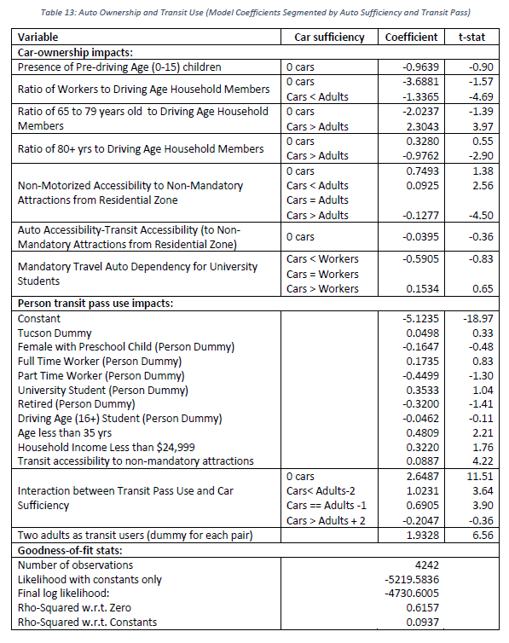
Treatment in AB Models –
MAG
Yes/no extension of auto ownership model (simultaneous)
Limited set of explanatory variables
If pass owned, assumption is transit trips see ½ of cash fare

Slide 6
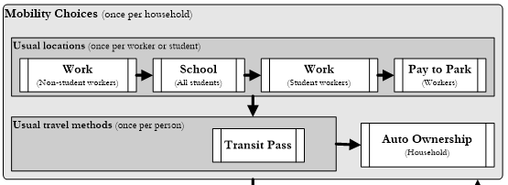
Treatment in AB Models - DaySim
Number | Variable | Coeff | Alternative | Description
1 | Pass_Cons | -1.2274 | own pass | constant
2 | PartTime | -0.3289 | own pass | part time worker
3 | OtherWkr | 0.3157 | own pass | other worker (student)
4 | UnivStud | 0.6073 | own pass | university student
5 | RetiredA | -0.9007 | own pass | retired adult
6 | NonWorkA | -3.2124 | own pass | non-working adult
7 | HiScStud | -1.9813 | own pass | driving age student
8 | ChildU16 | -2.4081 | own pass | child under 16
9 | LogHHIncm | -0.4133 | own pass | log of hh income
10 | MsgIncome | -4.6336 | own pass | missing income dummy
11 | MsgUWParc | 2.2437 | own pass | no usual work parcel
12 | MsgUSParc | 0.9319 | own pass | no usual school parcel
13 | HomeTDist1 | -2.8665 | own pass | Distance from home to nearest transit stop, up to 0.5 miles
14 | HomeTDist2 | -0.3659 | own pass | Distance from home to nearest transit stop, over 0.5 miles
15 | HomeTDistx | -0.5228 | own pass | Dummy for no transit stop within walking distance
22 | UWNoPath | -0.1813 | own pass | no transit path to usual work location
23 | UWGTDiff | 0.1719 | own pass | generalize time difference to usual work location with transit pass
25 | USNoPath | -0.8693 | own pass | no transit path to usual school location
26 | HAgLSWork | 0.7276 | own pass | home aggregate logsum worker
27 | HAgLSStud | 0.2382 | own pass | home aggregate logsum student
28 | HAgLSNonW | 0.4061 | own pass | home aggregate logsum non-working adult
29 | HAgLSReti | 0.3097 | own pass | home aggregate logsum retired
30 | WAgLSWork | 0.6044 | own pass | work-based aggregate logsum worker
31 | SAGLSScho | 0.4151 | own pass | school-based aggregatge logsum student
32 | CostChang | 0.0000 | own pass | change in cost of owning pass
Note: DaySim includes transit pass ownership cost as an input (very useful). Should also include cash fare cost? Parameters would probably need to be asserted according to elasticities.

Slide 7
Treatment in AB Models – DaySim
Additional fare discount fractions available
These are in addition to pass ownership
Useful for targeted policy analysis
Should we include similar parameters?
These can be coded via expression files too
PathImpedance_TransitUseFareDiscountFractions=true
PathImpedance_TransitFareDiscountFractionChildUnder5=0.8
PathImpedance_TransitFareDiscountFractionChild5To15=0.5
PathImpedance_TransitFareDiscountFractionHighSchoolStudent=0.5
PathImpedance_TransitFareDiscountFractionUniverityStudent=0.5
PathImpedance_TransitFareDiscountFractionAge65Up=0.5

Slide 8
Transit Pass Data

Slide 9
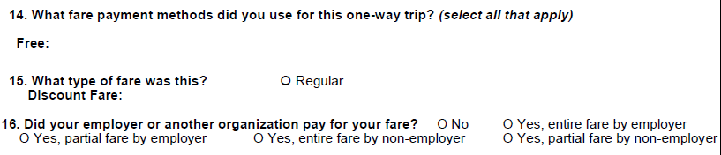
SEMCOG Data
No transit pass/fare information collected in 2015 household survey or in transit on-board survey “tour-based” person sample
2005 household survey has transit pass ownership at person level
  Type of pass(es, up to 3), whether it is paid for weekly, monthly, or annually, and whether the respondent paid for it or not
Limited set of explanatory variables in transit on-board survey (would only cover transit riders)
  Aggregate data available?

Slide 10
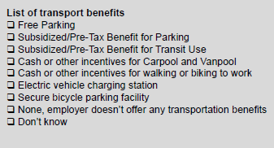
MWCOG Data
Household survey: each worker surveyed whether employer provides the following benefits:
Amount of benefit not collected, similar to SANDAG data
Transit surveys:
2016 Metrobus collected fare paid, whether subsidized
QL. DO YOU RECEIVE A MONTHLY TRANSIT BENEFIT FROM YOUR EMPLOYER?
00 | YES, EMPLOYER FULL SUBSIDY
01 | YES, EMPLOYER PARTIAL SUBSIDY
02 | YES, PRETAX PAYROLL DEDUCTION
03 | yes, both employer partial subsidy and pretax payroll deduction
04 | no

Slide 11
MWCOG Transit On-Board Survey Data
2016 Metrorail and Metrobus asks fare paid and type of transit subsidy from employer (full subsidy, partial subsidy, pretax payroll deduction, both partial and pretax, or none)
2016 VRE survey asks fare paid and type of subsidy (SmartBenefits transit subsidy, non-SB subsidy, pre-tax fare payment, parking, none). Also whether employer is federal gov’t
2016 MARC survey asks fare paid, but no subsidy data collected
2017 OmniRide collected employer type, whether ride subsidized, amount of subsidy (complete data)
2018 RideOn collected pass type but not subsidy

Slide 12
Recommended Form for ActivitySim

Slide 13
Proposed ActivitySim Transit Pass Ownership
Modeled at person level, before auto ownership
  Avoids of joint model structure with auto ownership, more important for other auto ownership extensions (vehicle type)
  Effect of subsidized passes could affect auto ownership
Explanatory variables to test
  Household variables (income, size, etc.)
  Person type, industry
  Transit vs auto accessibility to work, school
  (Discounted) cost of transit pass
  Nesting coefficient
Choice
Yes
Fully subsidized
No
Partially subsidized
Not subsidized

Slide 14
Key issues in model design\estimation
Availability of data to estimate model parameters varies by region
No good information on reasonable elasticities to cost of transit passes, probably not possible estimate cost coefficient due to cross sectional data.
Assume transit owning persons are insensitive to cost at the trip level? Some transit passes only good for certain systems\operators, could be problematic in regions with multiple operators.

